Slide 1
Network Fundamentals
CIS 480 – Intro to Network Security
Computer Information Systems
University of Louisville
Ghiyoung Im, PhD

Slide 2
Objectives
Identify the basic network architectures.
Define the basic network protocols.
Explain routing and address translation.
Classify security zones.
understand principles behind network layer services
Learn about transport layer protocols in the Internet

Slide 3
Network Fundamentals Outline
Basic Network Concepts
  Network Topologies
  Network Hardware
  Network Design
2. The OSI 7 Layers
3. Internet Protocol
IPv4
ARP & RARP
IPv6
4. Transport Protocol
UDP
TCP
ICMP

Slide 4
Network Architectures
Local area network (LAN)
  Typically smaller in terms of size and geographic coverage, and consists of two or more connected devices. Home networks and most small office networks can be classified as LANs.
MAN (Metropolitan Area Network)
Wide area network (WAN)
  Tends to be larger, covering more geographic area, and consists of two or more systems in geographically separated areas connected by any of a variety of methods.
Internet
  The global network that connects millions of systems.
Personal Area Networks (PAN)
  Wireless telecommunications network for device-to-device connections within a small range (e.g., Bluetooth)

Slide 5
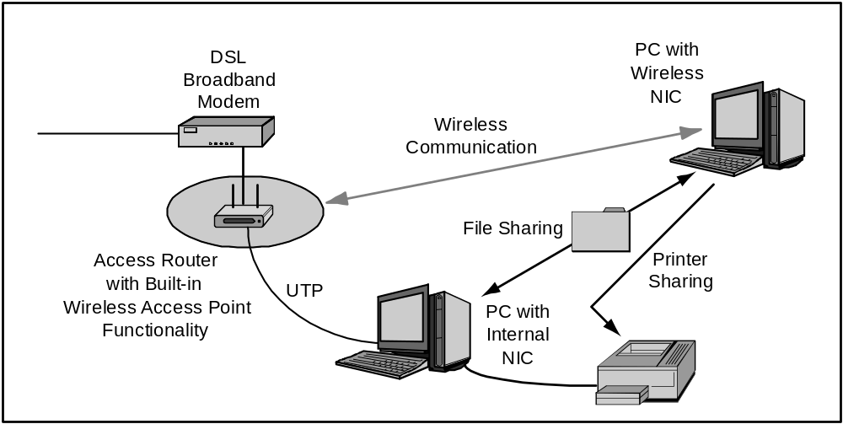
A-1: A Simple Home Network
* Panko, 2010

Slide 6
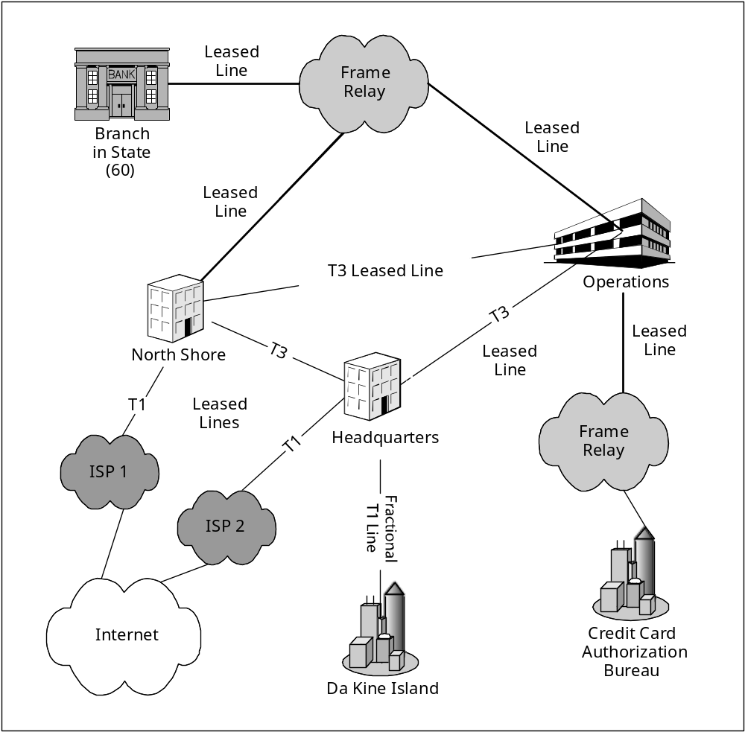
A-4: Wide Area Networks (WANs)
* Panko, 2010

Slide 7
A-5: The Internet
Network
* Panko, 2010
Notes:
The global Internet has thousands of networks connected by routers.

Slide 8
Network Topology
One major component of every network’s architecture is the network’s topology — how the network is physically or logically arranged
The main classes of network topologies are star, ring, bus, and mixed

Slide 9
Physical Network Topologies
Star:
  Systems are connected to a central device
Bus:
  Systems are connected to the same cable segment
Ring
  Systems are connected to each other in a closed loop
Mixed:
  Larger networks may employ multiple topologies at the same time

Slide 10
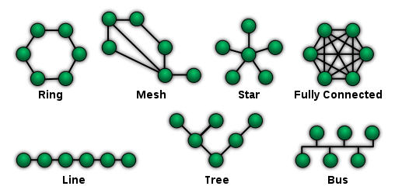
Network Topologies
* Wikipedia, 2011

Slide 11
Categories of Network Topologies
Physical Topologies | Logical Topologies
The shape of the cabling layout used to link devices | The way that the data passes through the network from one device to the next without regard to the physical interconnection of the devices
Ring, Star, Tree | Ethernet, Token Ring
Determined by the physical layout of cables, wires, and network devices | Determined by network protocols
A network's logical topology is not necessarily the same as its physical topology. | - Ethernet: Logical bus topology in a physical star topology - Token Ring: Logical ring topology in a physical star topology
* Wikipedia, 2011

Slide 12
Ethernet
The most popular media access protocol (layer 2) used on LANs
Local area network (LAN) technology developed by Xerox, Digital, Intel and commercialized in 1980 (IEEE 802.3)
Speed: 10 Mbps -> 10 Gbps
Shared media (bus topology)
  Development to Switched media (star topology): data is less public

Slide 13
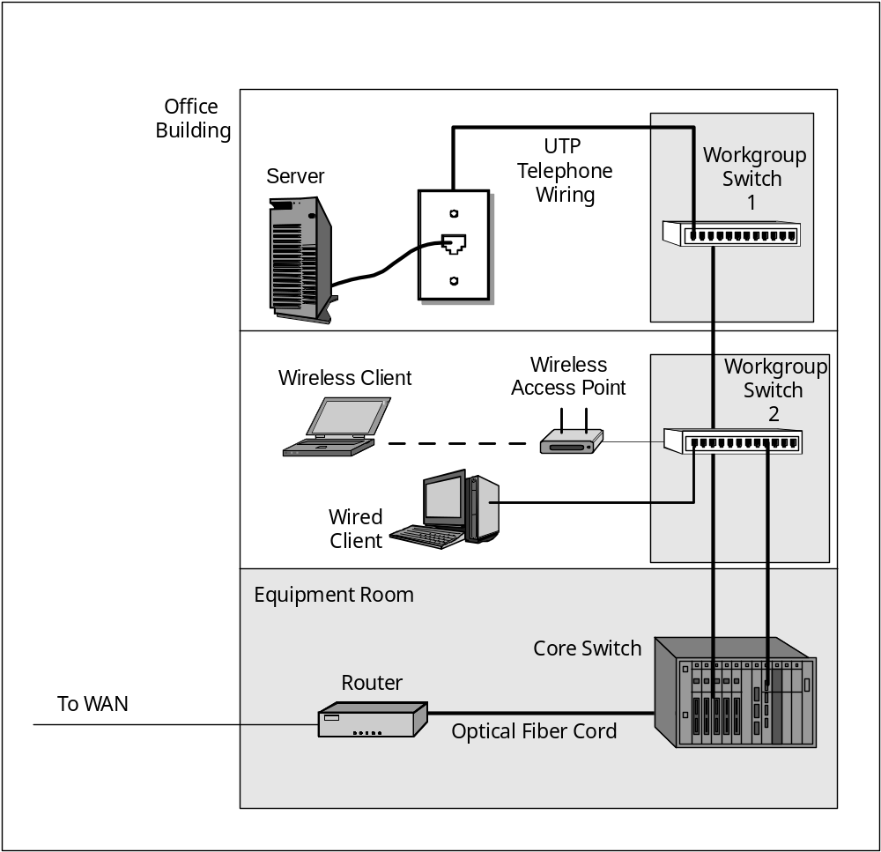
A-3: Building LAN
* Panko, 2010
Copyright Pearson Prentice-Hall 2010

Slide 14
Ethernet MAC
Multiple user share the same media
Media Access Control: CSMA/CD (Carrier Sense Multiple Access w/ Collision Detection)
Steps for communication:
  Check whether a user is transmitting data
  Wait when the data is transmitted
  Monitor to check whether collusions occurred

Slide 15
Ethernet: Unreliable, connectionless
Connectionless: No handshaking between sending and receiving NICs
Unreliable: receiving NIC doesn’t send ACKs or NACKs to sending NIC
  stream of datagrams passed to network layer can have gaps (missing datagrams)
  gaps will be filled if app is using TCP
  otherwise, app will see gaps
* Kurose, 2010

Slide 16
Ethernet Frame Structure
Preamble | Start of Frame Delimiter | MAC Destination | MAC Source | Length/Type | Data | CRC
7 Bytes of 10101010 | 1 Byte of 10101011 | 6 | 6 | 2 | 46~1500 | 4
Frame length:
  Min 64 to Max 1518 Bytes (except Preamble, SFD)
Maximum Transmission Unit:
  1500 Bytes (except Preamble, SFD, MAC header, CRC)

Slide 17
Ethernet Frame Structure (2)
Preamble:
  7 bytes of 10101010 followed by one byte of 10101011
  To synchronize receiver, sender clock rates
Addresses (6 Bytes)
  Vendor Code (OUI) + Serial Number
  Unique number
Length/Type:
  If > 0x600 => Type (DIX 2.0): indicates higher layer protocol
  If < 0x600 => Length (802.3)
CRC: for error checking

Slide 18
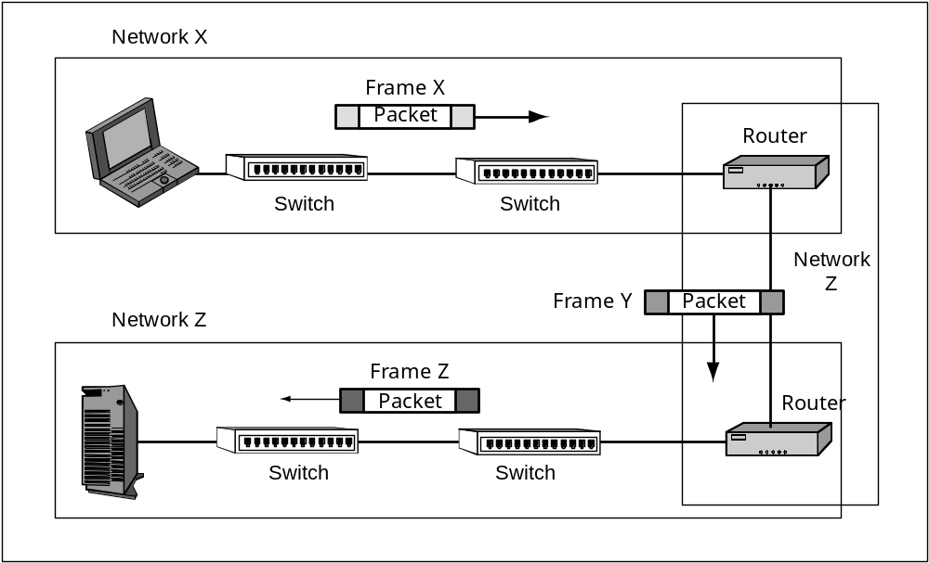
A-6: Frames and Packets
* Panko, 2010

Slide 19
Cabling Categories
Cat-1: Traditional phone line, voice
Cat-2: 4 Mbits/sec, voice/data
Cat-3: 10 Mb, voice/data
  Ethernet 10BASE-T, 4 Mb Token-Ring
Cat-4: 16 Mb, voice/data
  Not in use
Cat-5/5e: 100 Mb to 1Gb, voice/data
Cat-6: Gigabit Ethernet, voice/data

Slide 20
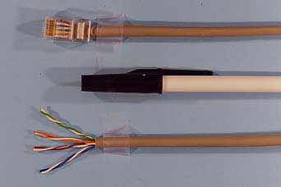
A-2: Unshielded Twisted Pair Wiring (UTP) Cord
* Panko, 2010

Slide 21
Hub
Replicates data it receives onto all ports
Employs star topology
Layer 1 device
Generally refers dummy hub
Does not have traffic monitoring capabilities
  All ports connected to hub can collide with one another (no CSMA/CD)
Switching hub
  Layer 2 device
  Delivers packets to the appropriate port based on the packet's address

Slide 22
Bridge
Connect two physical segments of a network
Switch: multiport bridge
Bridge: 2 port switch
Not in use => Switching Hub, LAN Switch, Brouter (Bridge + Router)

Slide 23
Switch
Layer 2 Switch
Each port has a MAC address and forward a data frame to its destined segment/system
Characteristics
  Fast: uses ASIC, not CPU
  Microsegmentation of a network
  Multiport Bridge
  Each port can have a dedicated channel and uses full-duplex
Layer 3 Switch
  Make decisions based on IT address

Slide 24
Router
Layer 3 device
Connect different logical networks
  Switch, Bridge: connects physical segments on the same logical network
Forward packets based on IP addresses
  Drop packets if the destination is not known
  Need explicit configuration that has routing paths
  Drop MAC-level broadcast traffic

Slide 25
Virtual LAN (VLAN)
Segment a physical segment into different logical networks
Load balancing, reduced broadcast
Security: Systems on separate VLANs cannot directly talk to each other
Flexibility: use software for reallocation
Type:
  Port-based VLAN (Layer 1)
  MAC address-based VLAN (Layer 2)
  IP address-based VLAN (Layer 3)
  Protocol-based VLAN (Layer 1-3)

Slide 26
Network Access Control
A user’s computer cannot connect to a network until it meets defined policy standards such as malware protection level, patches, and configuration
A computer should be scanned and checked by a pre-installed software agent prior to the connection
Goals
  Mitigation of zero-day attacks
  Policy enforcement
  Identity and access management
* Wikipedia, 2011

Slide 27
Network Design
Untrusted zone: Internet
Semi-trusted zone: Web, Mail servers
Trusted zone: DNS for inner network, Database and Application servers
Firewalls:
  Between untrusted zone and semi-trusted zone
  Between semi-trusted zone and trusted zone
  Between entities with different trust levels

Slide 28
Demilitarized Zone (DMZ)
A computer host or small network inserted as a "neutral zone" between a company's private network and the outside public network
It prevents outside users from getting direct access to a server that has company data
In addition, endpoint security controls, s.a. firewall, antivirus and patch management, should be implemented
* searchsecurity.techtarget.com

Slide 29
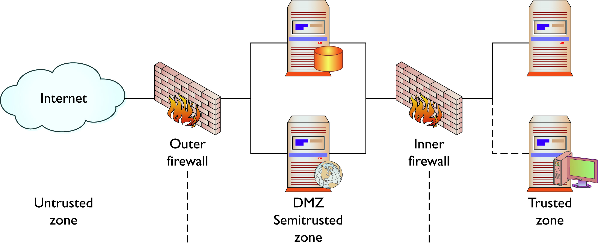
DMZ and Firewalls
* Conklin & White, 2010

